Slide 1

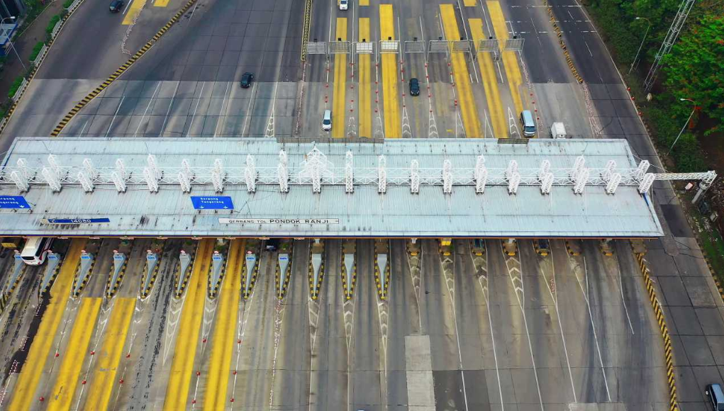
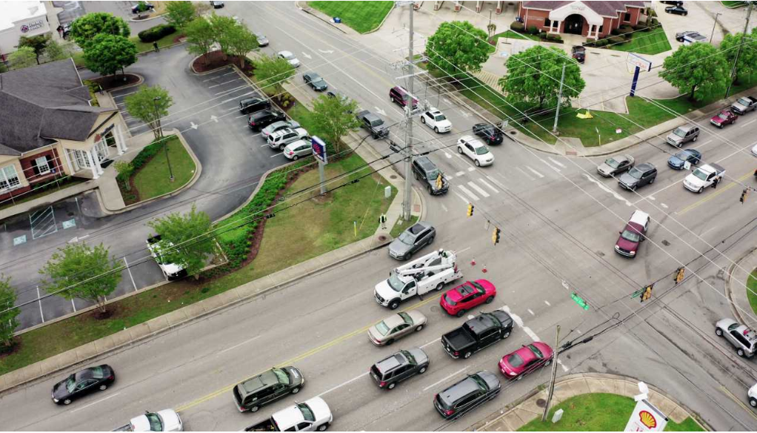

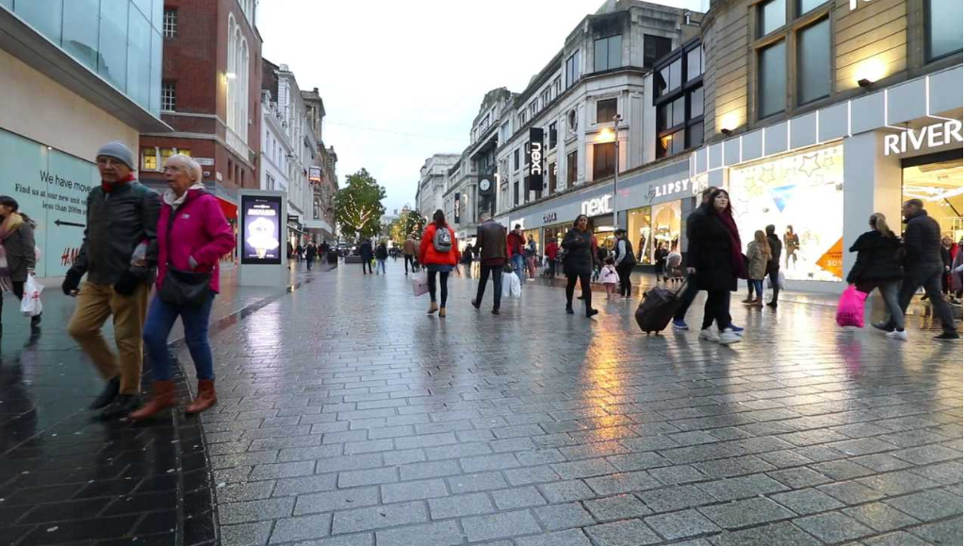
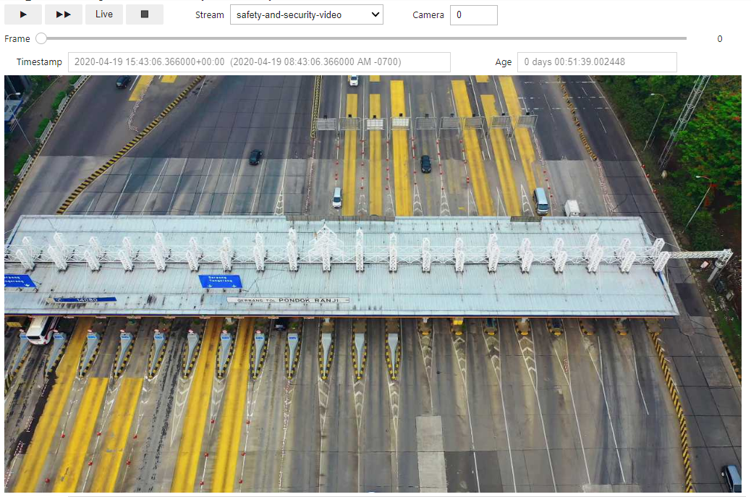
Storing and Retrieving Video with SDP
Streaming Data Platform
Pravega
Long Term Storage
Jupyter Notebook Server
(simulated)

Slide 2

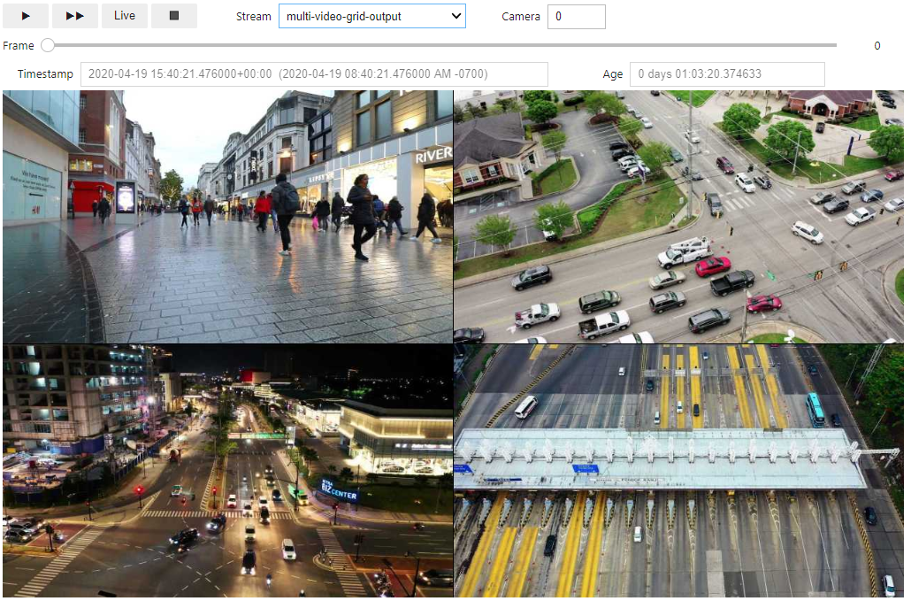
Using Flink to Read and Write Streams
Streaming Data Platform
Pravega
Long Term Storage
Jupyter Notebook Server
(simulated)

Slide 3
Multi-Video Grid Flink Job
Original Video Stream
Multi-Video Grid Flink Job
Grid Video Stream
Jupyter Notebook Server
Flink Job:
Align videos by time window
Decode images
Resize images
Encode images
All parallelized and in order
(simulated)

Slide 4
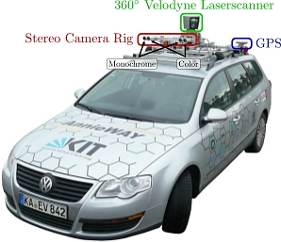
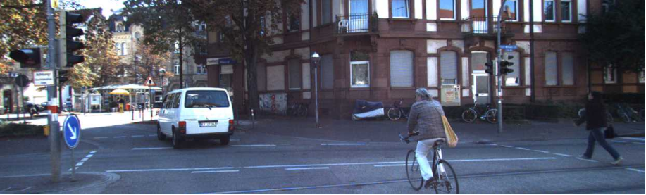
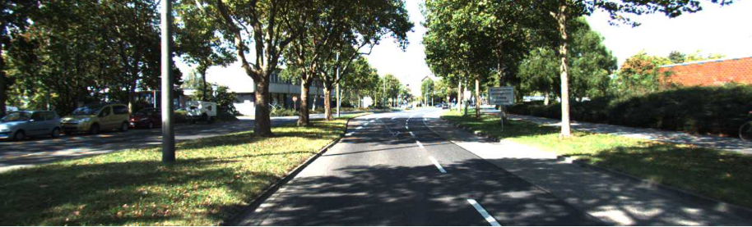
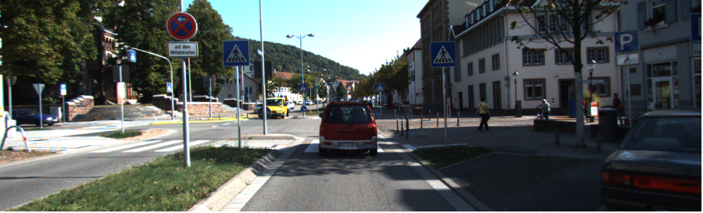
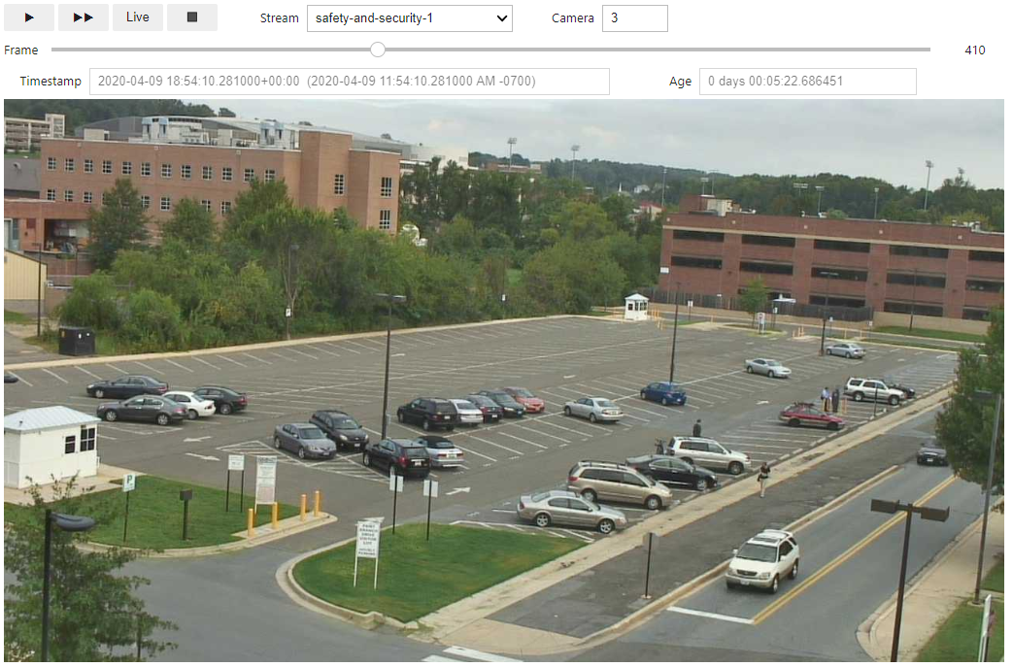
Object Detection Flink Job
Raw Sensor Stream
Enriched Sensor Stream
Jupyter Notebook
Server
Object Detection
Flink job
GPU accelerated
TensorFlow
YOLO model
Long Term Storage
Long Term Storage
(simulated)
Notes:
Camera Recorder
non-Flink application that reads frames from a video camera and writes to Pravega
Video Data Generator Job
Flink application that simulates additional cameras and writes to Pravega
Multi-Video Grid Job
Flink application that combines multiple camera feeds into a single feed
Video Player
Non-Flink application that reads video from a Pravega stream and displays it on the screen

